Slide 1
Hygge
A website for chilling

Slide 2
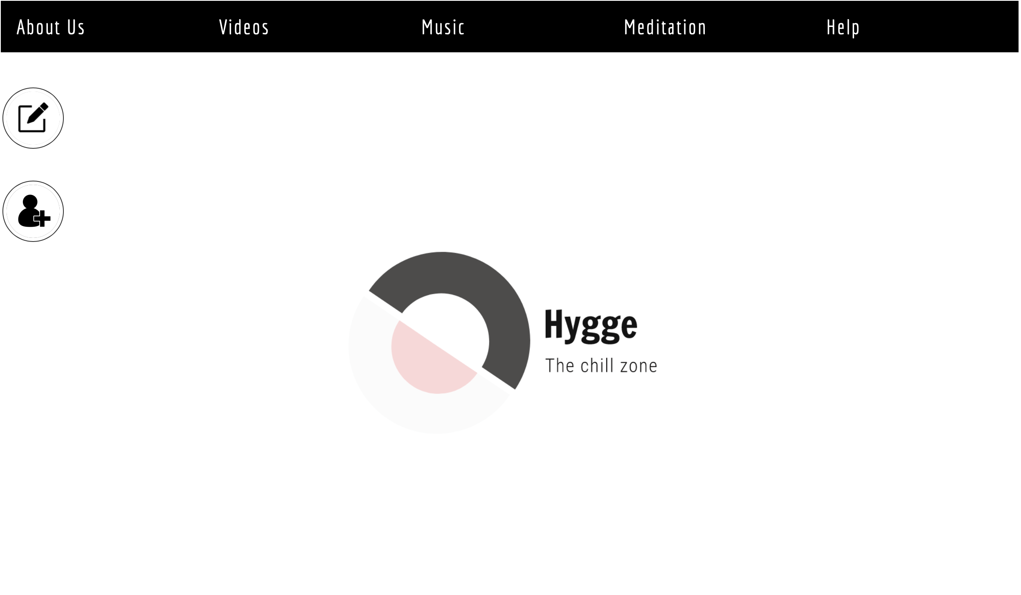
MVP-1 demo

Slide 3
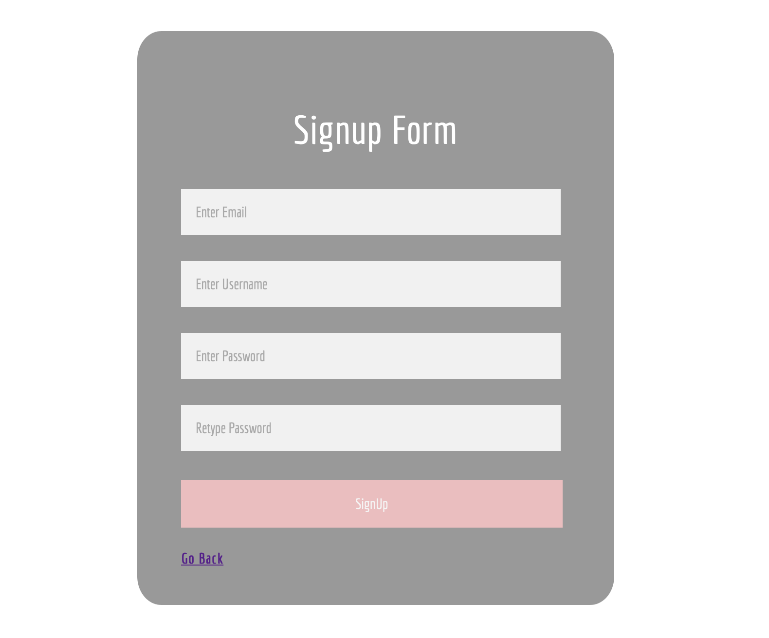
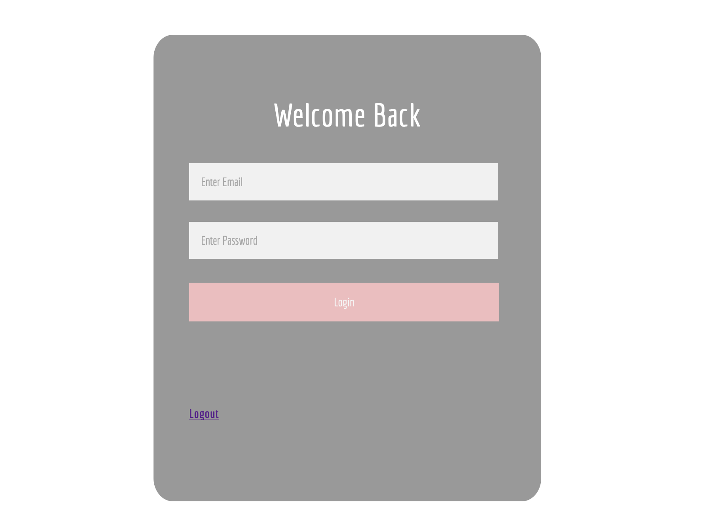
MVP-1 Demo

Slide 4

MVP-1 Demo
Demo
MVP-1 = Successful
Yes to clean code

Slide 5

Construction & development changes
Functional Requirements Document
Screenshots of current User Interface
Now includes our updated diagrams
Sequence Diagram
MVC Diagram
Class Diagram

Slide 6
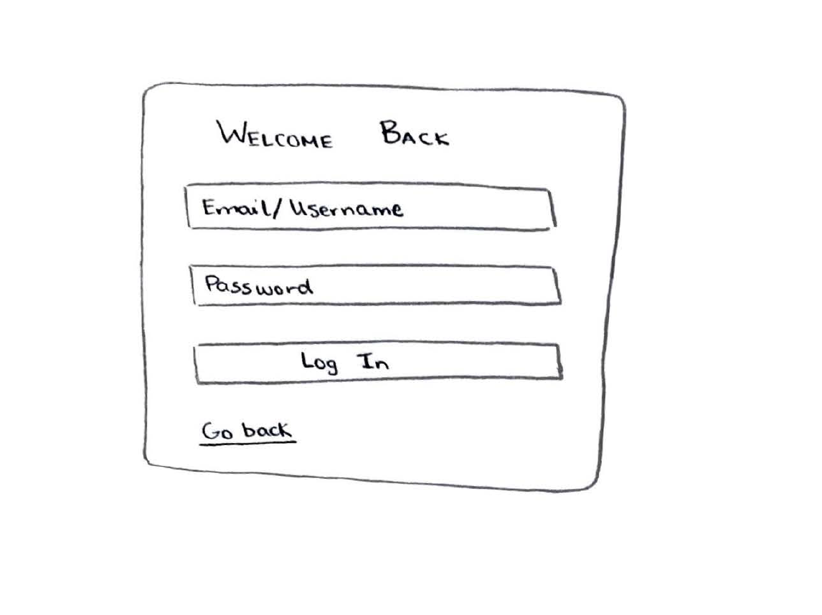
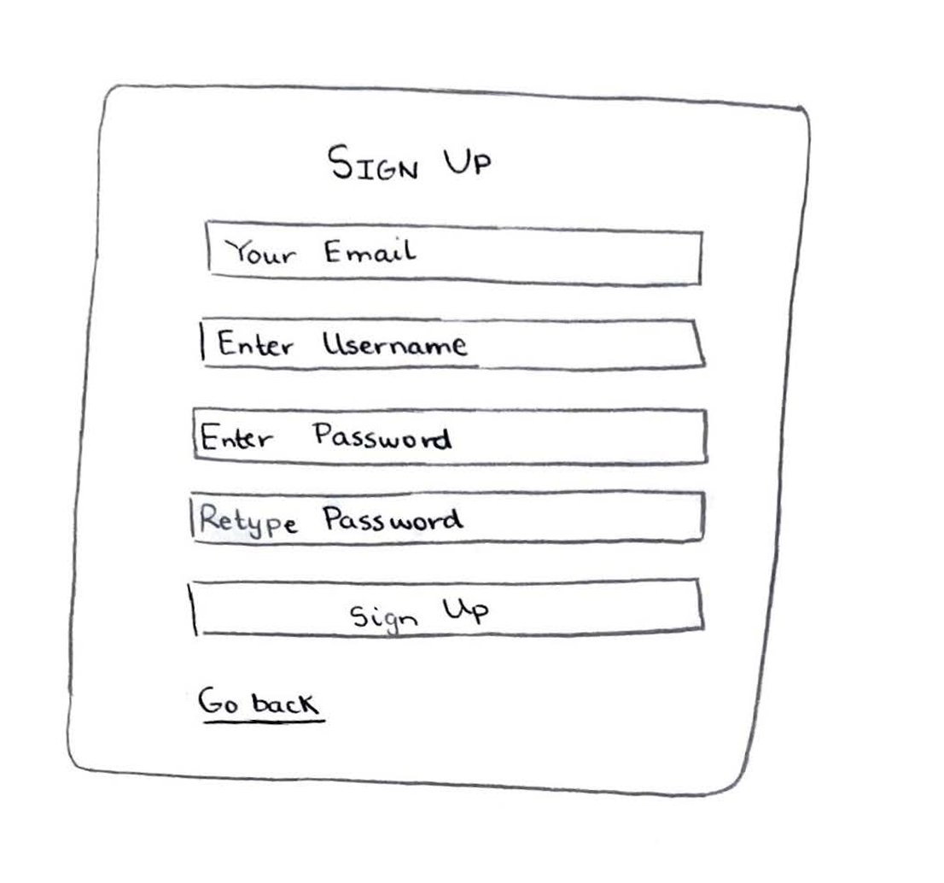
Updated Lofi

Slide 7
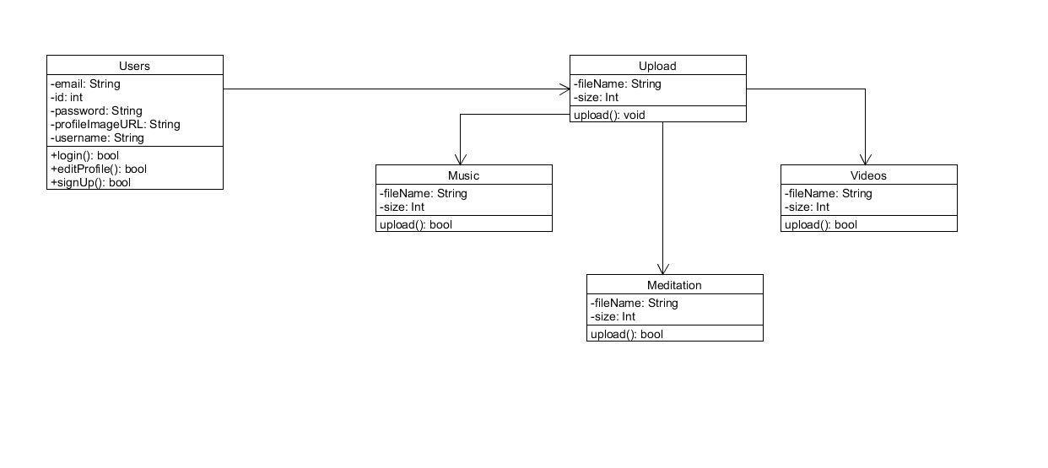
Updated Class Diagram

Slide 8
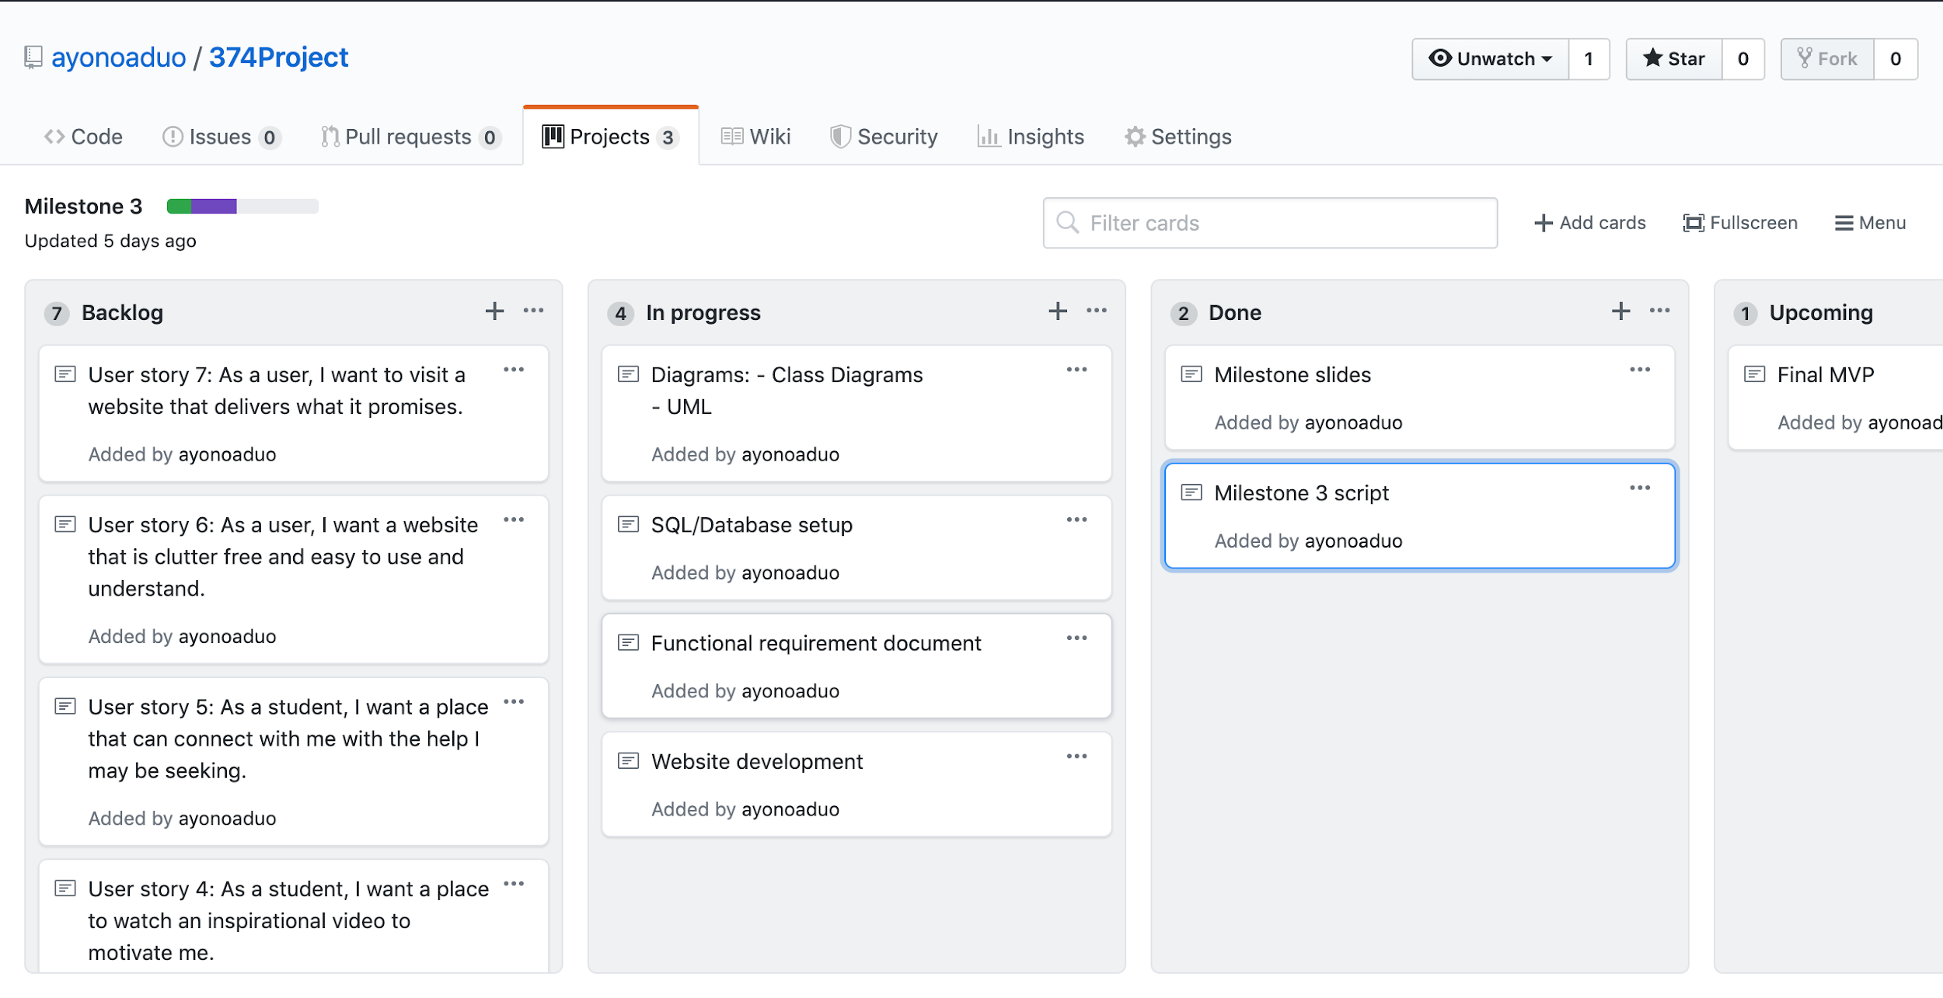
Updated Kanban

Slide 9

MVP-2 & GitHub
Discuss your team’s plan for the last MVP
Add content to dropdown menus
Barriers = Crunch Time
GitHub structure is consistent
Same setup is used

Slide 10

Group reflection
Keep up with progress of project/MVP-1
No particular dislikes
Hard to collaborate on code equally
Have a team lead for code
Input and feedback

